Slide 1
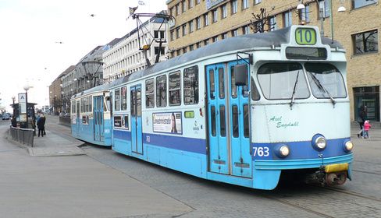
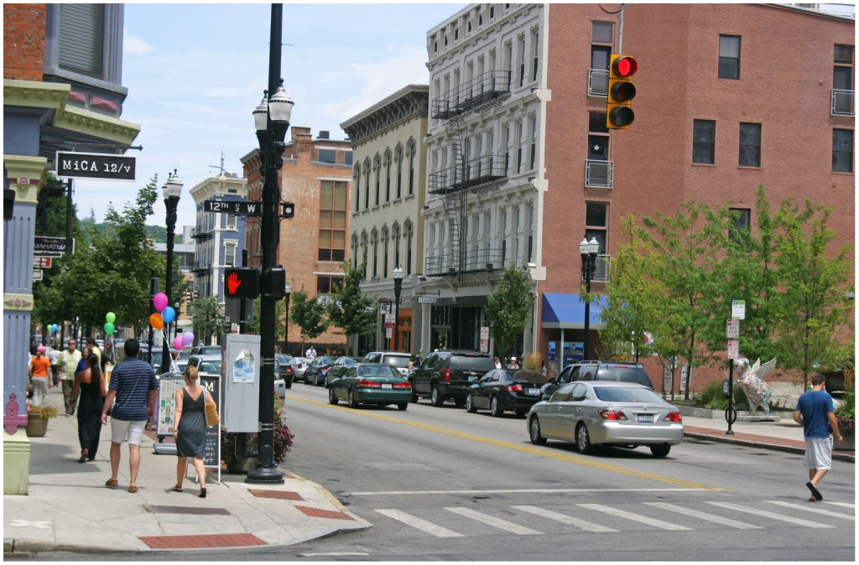
Density (Compactness)
slanich.zenfolio.com (Gothenburg, Sweden)
Walkable yet enough people to support transit
40 to 200 acres
7 to 8 du/acre
Suburbia = ~2
Density supports
Transit service
Retail shops
District energy system
Density protects
undeveloped & sensitive lands
Farr 2008
streetsblog.net (Cincinnati, Over-the-Rhine)
Notes:
Density > 7 or 8 dwellings/acre
(Suburbia is ~2 dwellings/acre, not walkable)
Achievable w/ spectrum of housing types
Multifamily to large-lot detached single family
Reduced building envelope of multifamily dwellings saves 30-35 % HVAC
Center w/ apartments above stores
“Built in” customers
Walking replaces car trips
District energy systems
Less paved area / person
Save natural areas

Slide 2
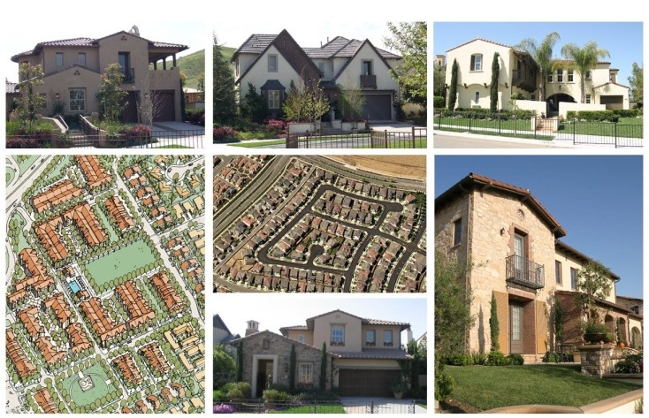
Low Density Residential
www.ontarioplan.org
Notes:
(2.1 - 5.0 du/acre)

Slide 3
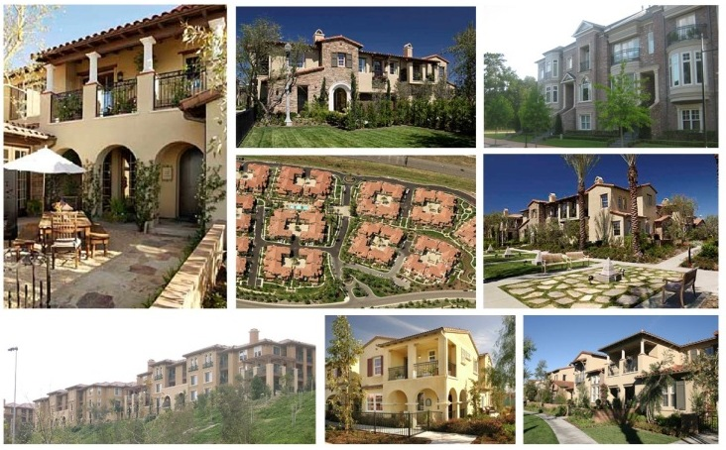
Medium Density Residential
www.ontarioplan.org

Slide 4
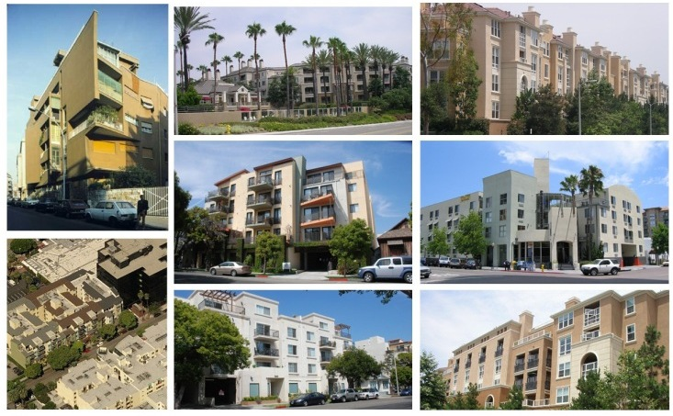
High Density Residential
The High Density Residential land use designation allows between 25.1 and 45.0 dwelling units per acre and accommodates single-family attached dwellings, including stacked flats and mid-rise and high-rise residential complexes.
High Density Residential (25.1 - 45.0 du/ac)
www.ontarioplan.org

Slide 5
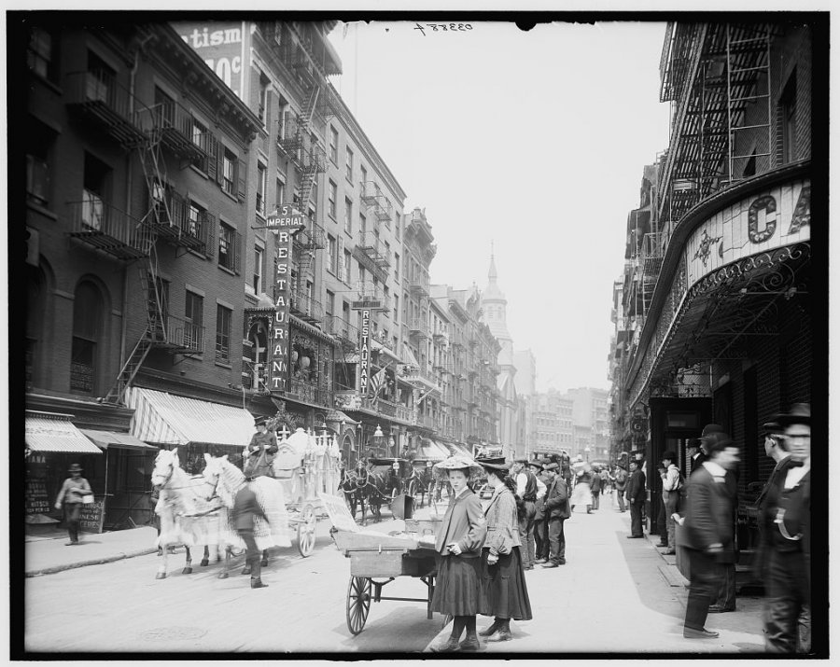
NYC Mott Street (Chinatown) c1900
www.businessinsider.com

Slide 6
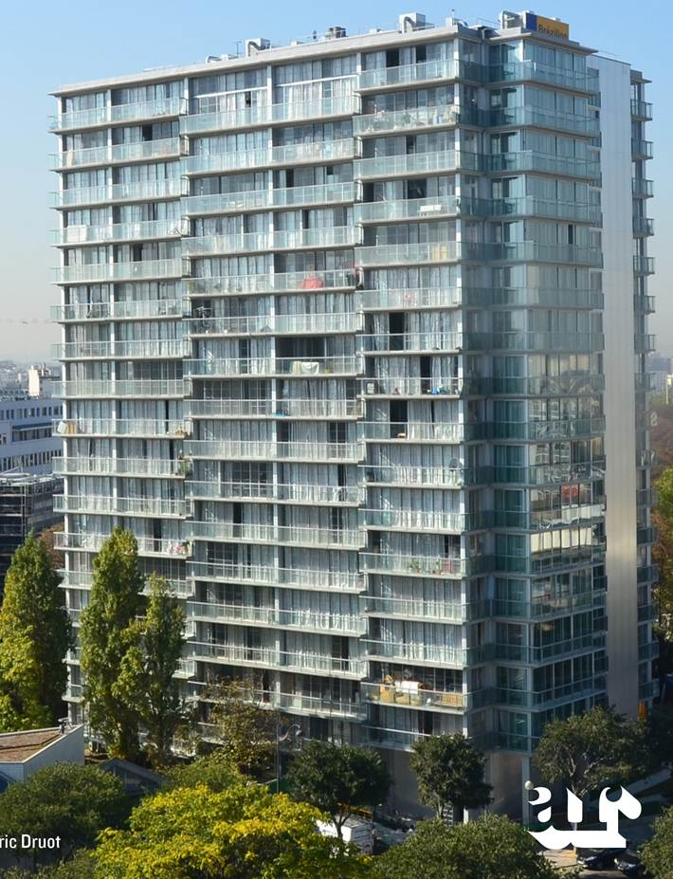
High Rise Stacked Flats (75 – 150 + du/acre)
www.architectural-review.com
Paris

Slide 7
Travel and Density
Farr 2008

Slide 8
Stormwater Runoff and Density
Houses on One Acre | Imperious Cover (%) | Total Runoff (ft³/yr) | Runoff per Dwelling (ft³/yr)
1 | 20 | 18,700 | 18,700
4 | 38 | 24,800 | 6,200
8 | 65 | 39,600 | 4,950
Farr 2008

Slide 9
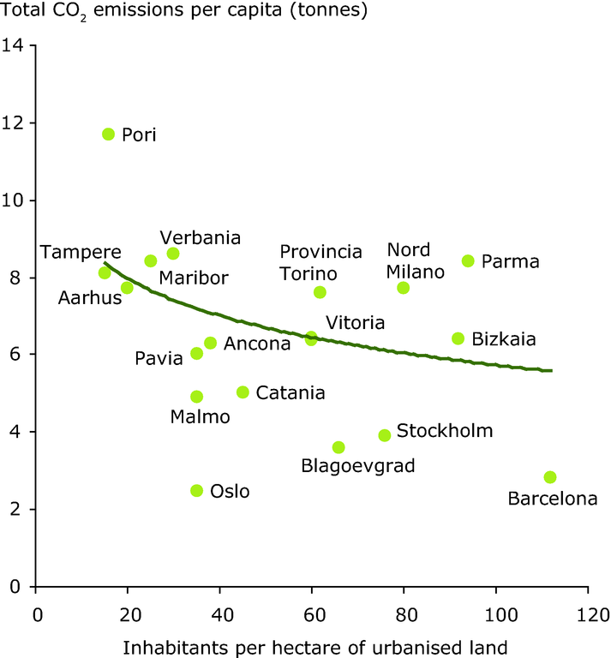
www.eea.europa.eu, 2002

